Slide 1

Unified Data Management
VCristina

Slide 2
Introduction
UDM - a cloud-native network function
-centralizes user data and makes it readily available for diverse network activities
-is related to the 3GPP 5G Architecture
-supports the ARPF (Authentication Credential Repository and Processing Function)
-stores the long-term security credentials used in authentication for Authentication and Key Agreement (AKA).

Slide 3
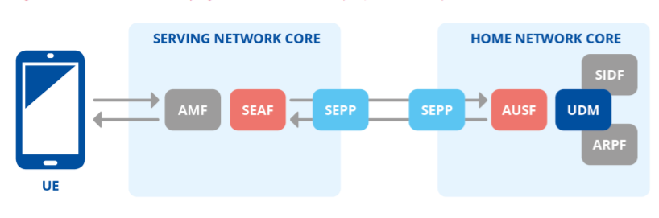
Primary Authentication
5G-AKA
Mutual authentication between the UE and the network.
Key element: AUSF (Authentication Server Function).
AUSF uses services of UDM (Unified Data Management) and ARPF (Authentication Credential Repository and Processing Function)

Slide 4
Functions
The UDM
Manages data for access authorization, user registration, and data network profiles.
Separates data from function
It can be paired with the user data repository (UDR)
Depending on the construction of the 5G architecture, both UDM software and the UDR can send and store data.

Slide 5
Stateful and Stateless Versions
Stateful
Stateless
Stores data locally
Shares data among microservices
Disadvantage: if an issue occurs, all microservices sharing information must be removed from the network at the same time
Stores data externally in the UDR
Keeps subscriber data separate
UDM function retrieves the data
Disadvantage: multiple nodes cannot update the same points of information at the same time, causing network slowness

Slide 6

3GPP SECURITY STANDARDS
TS 33.501
Security Assurance Specification
Clause 5.8.1 defines generic requirements on the Unified Data Management (UDM)
requirements for the long-term keys used for authentication and security association setup processes.
these keys shall be protected from physical attacks and shall never leave security environment unprotected.
Clause 5.8.2 (Subscriber privacy related requirements to UDM and SIDF)
protection of the Home Network Private Key in the UDM

Slide 7
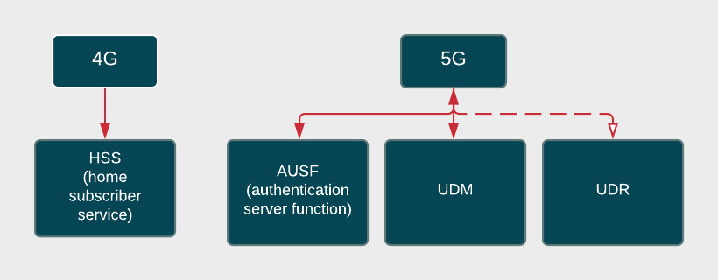
Differences between 4G and 5G

Slide 8
Thank you!
Do you have any questions?

Slide 9
References
[1]https://www.etsi.org/deliver/etsi_ts/133500_133599/133501/15.04.00_60/ts_133501v150400p.pdf
[2] https://www.sdxcentral.com/5g/definitions/what-is-unified-data-management/
[3] https://www.gsma.com/security/nesas-security-assurance-specifications/
[4] https://www.mpirical.com/glossary/udm-unified-data-management
https://www.enisa.europa.eu/publications/security-in-5g-specifications

